Slide 1
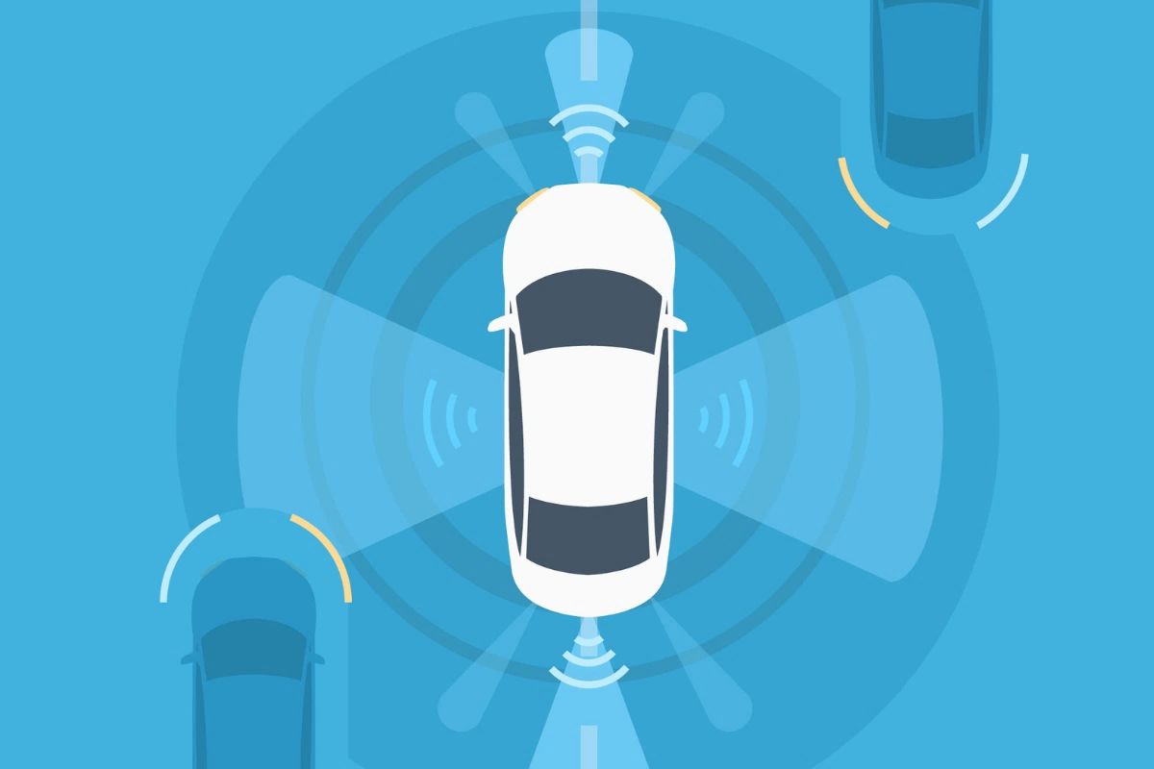
CAR Safety System
A perfect solution to ensure safety during driving

Slide 2

Team Members
01
02
03
04
Samina Mahjabeen
S.M. Tasnimul Hasan
180204129
180204142
MD Shohanur Rahman
MD Zahidul Haque
180204127
180204136

Slide 3
Objectives
01
02
03
04
05
06
To reduce car accidents
To reduce the concequences
Safety of the passenger
In Bangladesh road accident has become a scenario
Many people die or get disabled for life because of Accidents
Passengers will have to wear seatbelts and an airbag will be ready for disposal.
Safety of the driver
Safety of the passer by
No more overspeeding
The driver will be forced to wear seatbelt
If an obstacle is detected the car will stop or give alart.
We hope to make our roads more safer than ever.

Slide 4
Social Values
01
02
03
Economical
Reducing Accidents
A safe society
The solution will be affordable for every car
This automated safety system will hopefully reduce trrafic accidents
We hope to achive a safe environment for passengers, drivers and passer by

Slide 5
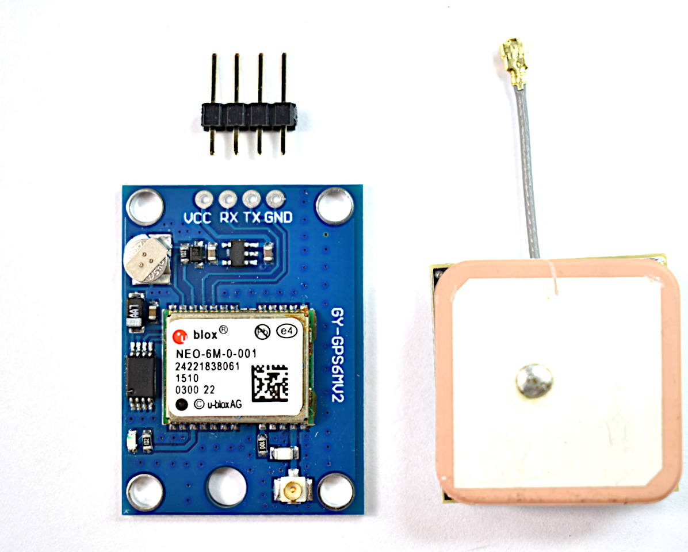
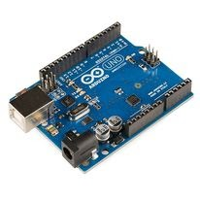
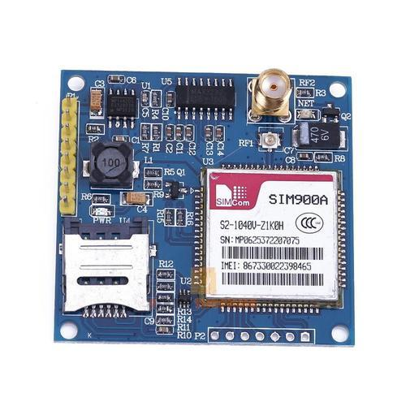
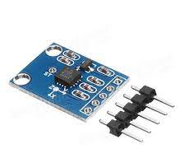
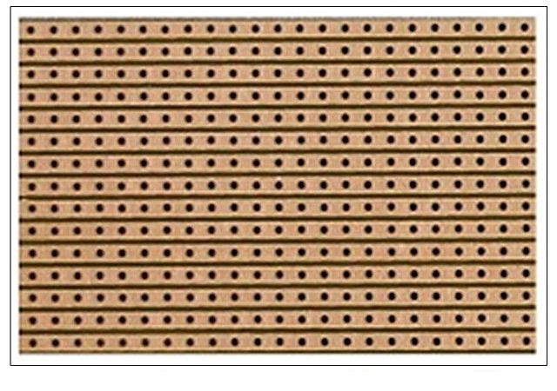
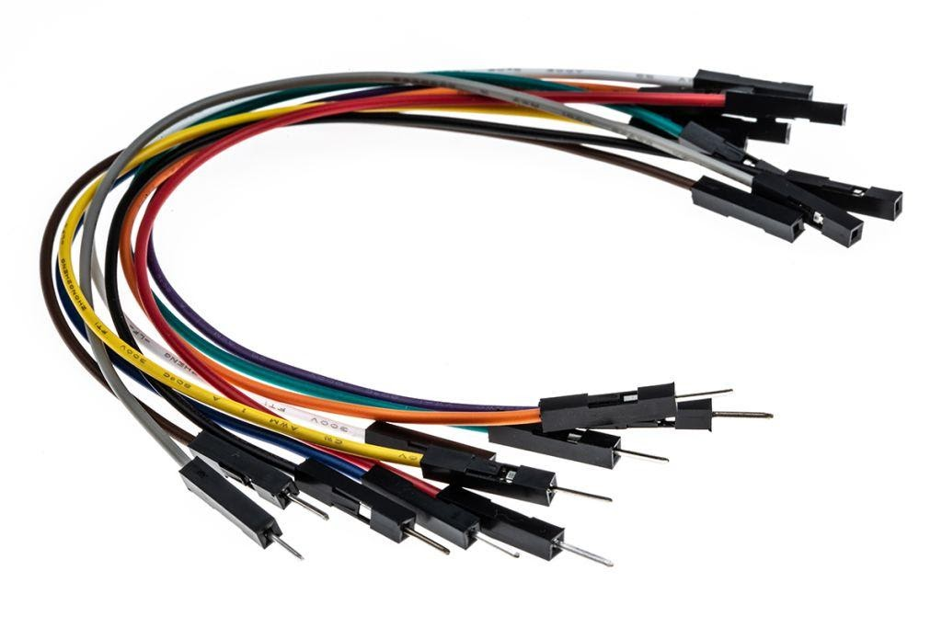
Recquired Components
Auduino Mega
SIM 900A GSM Module
NEO 6M GPS Module
ADXL335 Accelerometer Sensor
Dotted Veroboard
Connecting Wires

Slide 6
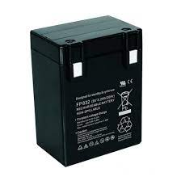
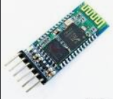
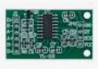
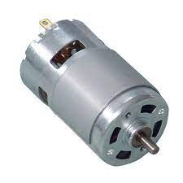
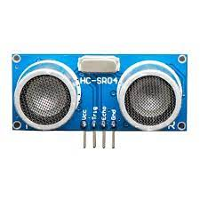
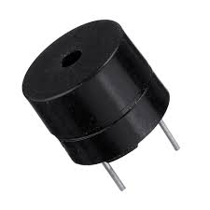
Recquired Components
8v Battery
HX711AD Weight Sensor
Bluetooth Module
Buzzer
Ultrasonic Sensor
DC Motor

Slide 7
OUR FEATURES
Auto seatbelt detection
Auto airbag disposal
Overspeed control
SOS message sending
Obstacle Detection
Full control
A
D
Our system will alarm the passenger to wear seatbelt
Airbag will be ready during emergency
B
E
It will alarm the driver when speed goes up to a certain level
An automated message will be sent to emergency contact
C
F
If something is in front of the car, it will detect
Driver wll be able to control all features through android interface

Slide 8
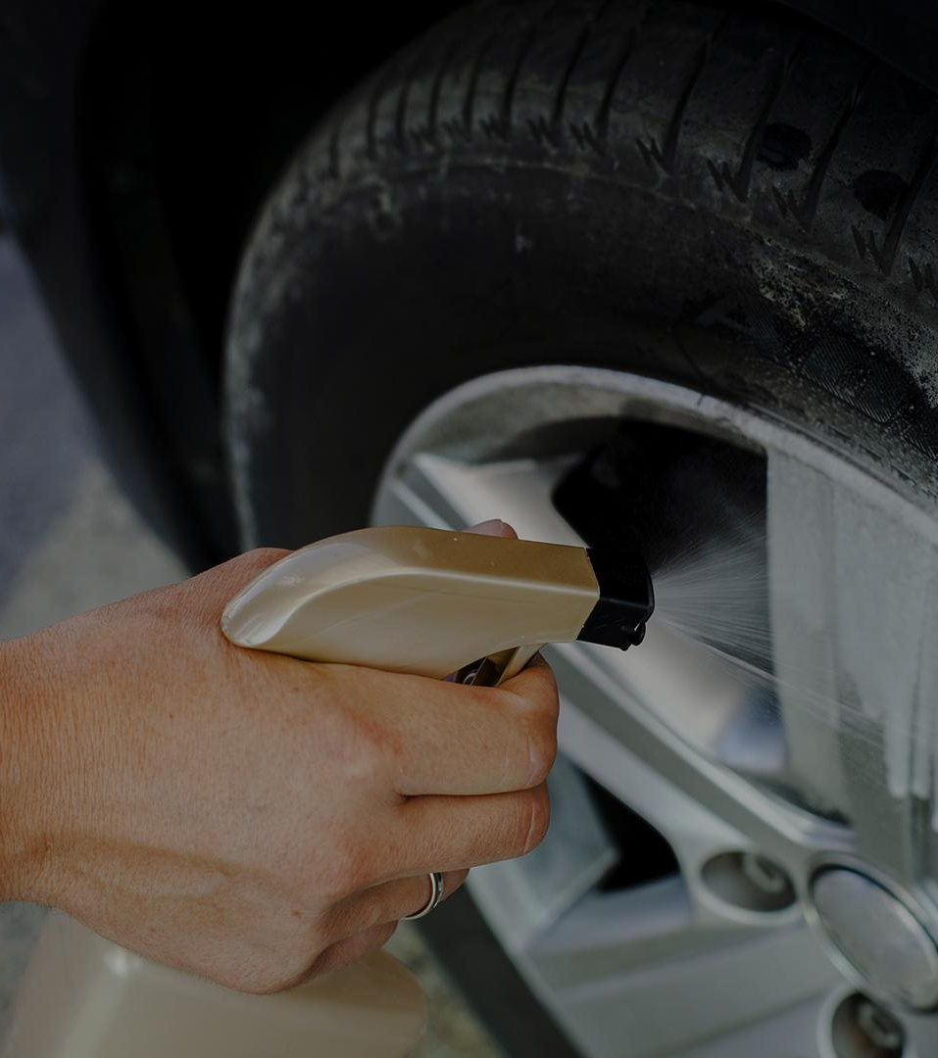
Working Procedure

Slide 9
PROBLEM VS. SOLUTION
PROBLEM
SOLUTION
Passengers and drivers often forget to fasten their seatbelts or they don’t tie seatbelts because of ignorance.
Our HX711AD Weight Sensor will detect a person in seat and alert him to fasten seatbelt. ADXL335 Accelerometer Sensor will ensure the car is in moving state.

Slide 10
Problem
Solution
Many driver stays busy with phone or other work and they do not notice sudden obstacles
Our ultrasonic sensor will detect sudden obstacles and alarm the driver through Buzzer

Slide 11
Moreover
Over Speed Control
Automated SOS sending
ADXL335 Accelerometer Sensor will detect over speeding and alarm the driver.
NEO 6M GPS Module will detect current coordinates of the car and SIM 900A GSM Module send it to an emergency contact during critical situation

Slide 12
Estimated Budget
Equipment | Quantity | Budget (Tk)
Arduino Mega 2560 R3 | 1 | 1450
SIM9001 GSM GPRS | 1 | 700
NEO-6M GPS | 1 | 450
Accelerometer ADXL335 | 1 | 390
Vero Board (Dotted) | 1 | 25
HX711AD Weight Sensor | 1 | 140
12V 300RPM DC Motor | 2 | 520
Buzzer | 1 | 15
HC-05 Bluetooth Module | 1 | 275
Connecting Wire | As required | 100
8 Volt Battery | 2 | 110
Ultrasonic Sensor | 1 | 100
Total |  | 4275

Slide 13
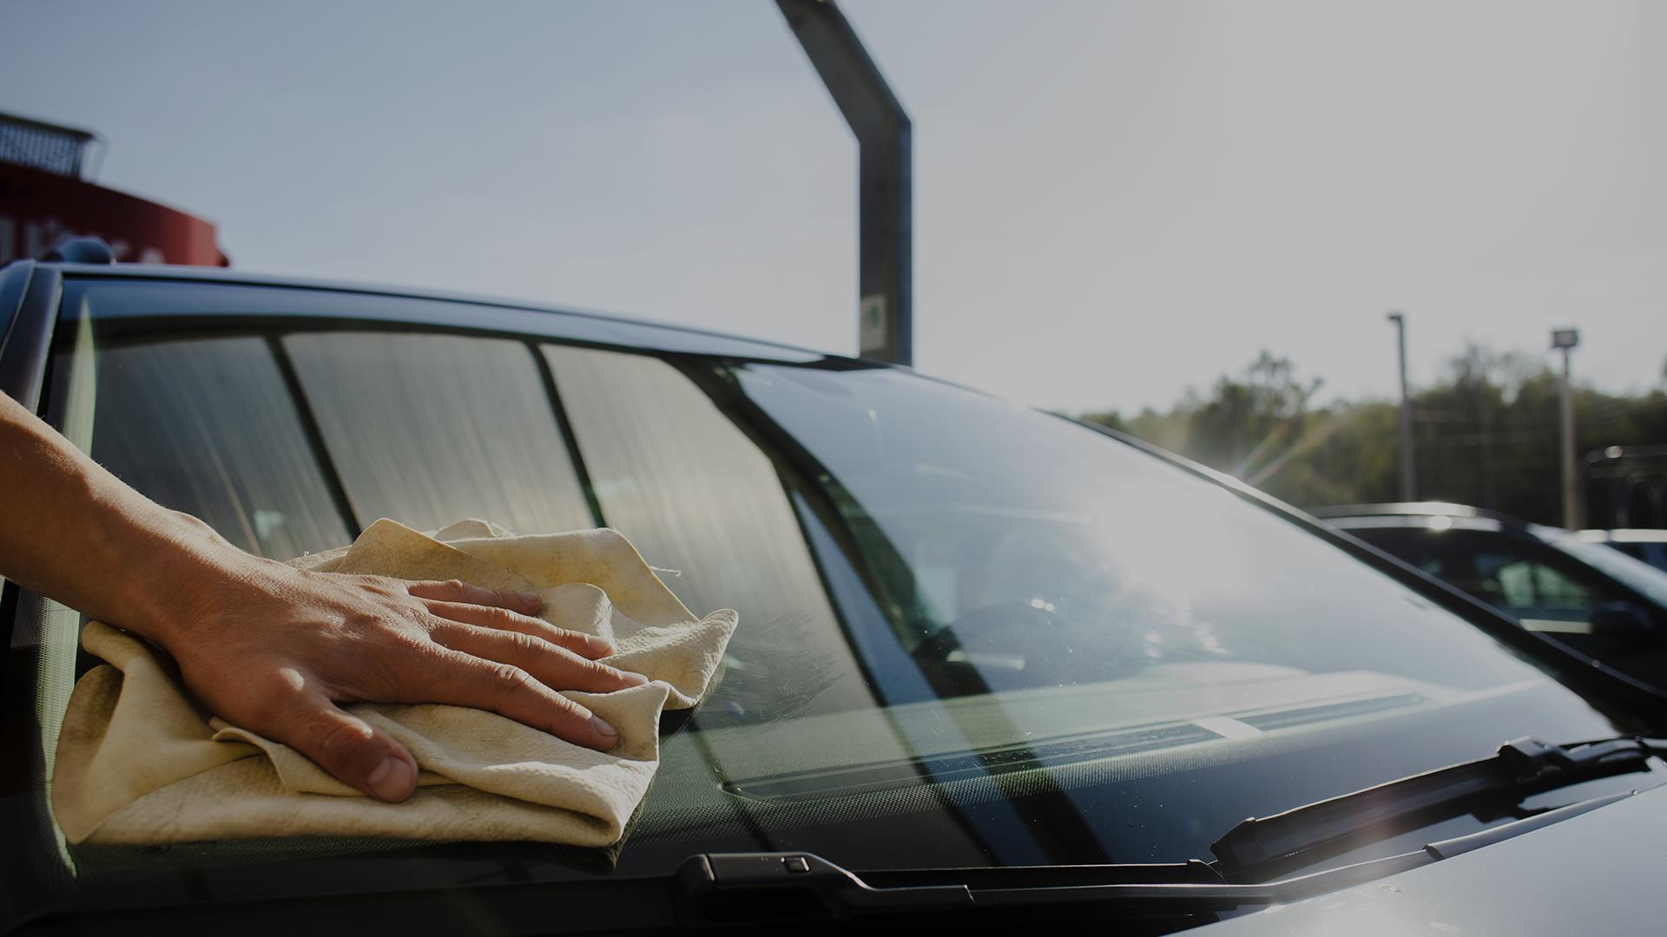
Conclusion
Road accidents are increasing day by day in recent times. Our system will reduce the occurrence of car accidents and its consequences.
We hope to make Bangladesh a safer place

Slide 14
Any Question
Thank You

